Slide 1

Daily Review
Scientists make observations of the world. From those observations, they infer a likely explanation. Scientists test their inferences using the scientific method.
The first part of the scientific method involves
a question to answer
an aim for the experiment
a hypothesis
Question: Does the temperature of the milk change how fast milo dissolves?
Aim: To find out if the temperature of the milk affects how fast milo dissolves.
Hypothesis: Hot milk dissolves milo faster than cold milk.
Vocabulary
Hypothesis: a testable statement

Slide 2

Daily Review
From the information below write an aim and a hypothesis for this experiment.
Observation: Plants that are watered with fertiliser grow well.
Inference: The fertiliser helps plants to grow.
Question: Does watering plants with fertiliser make them grow faster?
Aim:
Hypothesis:
To find out if watering plants with fertiliser affects their growth.
Watering plants with fertiliser increases their growth.
Vocabulary
Hypothesis: a testable statement

Slide 3
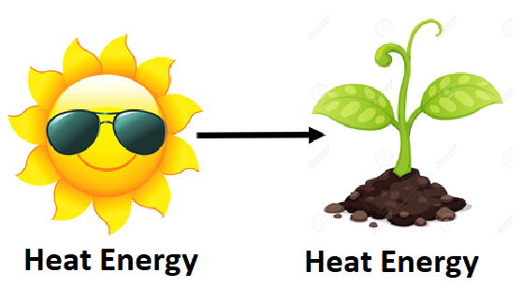
Daily Review
Energy: transferred or transformed?
Has the energy moved without changing form? Yes = transfer Has the energy changed form? Yes = transformation Write a full sentence response: This is energy transfer / transformation because ________ has been moved / changed ________.
This is energy transfer because heat energy from the sun has been moved to the plant without changing form.
Reminder
Kinetic: Movement Heat: Warms things up Light: Brightness / lets us see Sound: Vibrating objects / can be heard Electrical: Movement of electric charges Elastic: Stored in compressed / stretched objects Gravitational: Stored in objects high up Chemical: Stored in chemical bonds Nuclear: Stored inside atoms

Slide 4

Daily Review
Energy: transferred or transformed?
Has the energy moved without changing form? Yes = transfer Has the energy changed form? Yes = transformation Write a full sentence response: This is energy transfer / transformation because ________ has been moved / changed ________.
This is energy transformation because:
The jumper’s gravitational energy has been changed into kinetic energy
Elastic energy in the bungee cord has been changed into kinetic energy
Reminder
Kinetic Heat Light Sound Electrical Elastic Gravitational Chemical Nuclear

Slide 5
Energy Flow Diagrams Year 8 Science

Slide 6
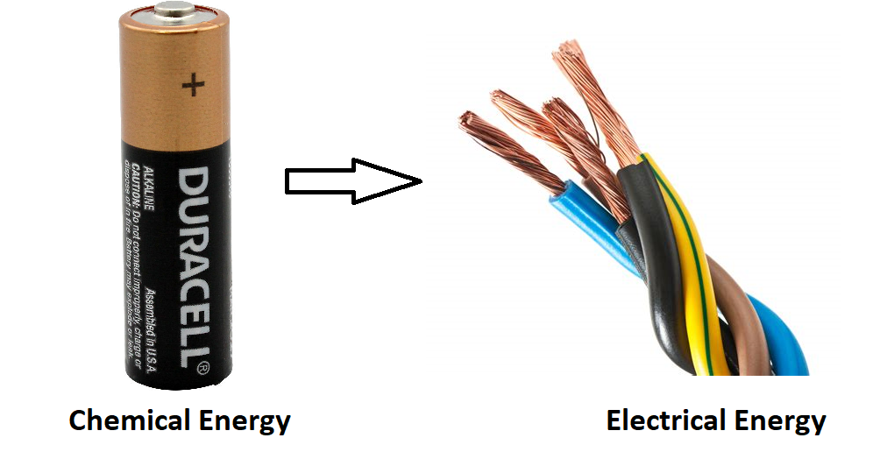
Learning Objective
CFU
What are we going to learn?
Draw energy flow diagrams for simple energy transformations in common objects.
Activate Prior Knowledge
When energy is changed from one type of energy to another, we say it has been transformed. For example, chemical energy in a battery can be transformed into electrical energy in a wire.
Think, Pair, Share: on your whiteboard, draw a diagram to represent this transformation.

Slide 7
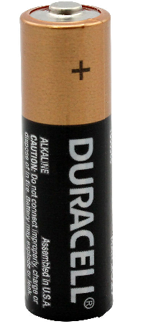
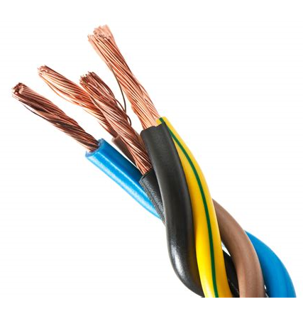


Concept Development
CFU 1
What are energy flow diagrams used for?
Drawing Energy Flow Diagrams
Energy flow diagrams are used to represent energy transformations visually.
Different forms of energy are connected by arrows which point from the input (starting) energy form to the output (final) energy form.
CFU 2
How are different energy forms connected in flow diagrams?
CFU 3
Which direction do the arrows point?

Slide 8



Concept Development
CFU 1
How many energy transformations are there in a mobile device?
Extended Flow Diagrams
In some situations there may be more than one energy transformation.
In these situations, multiple arrows are used.
For example, in a phone or MP3 player:
Chemical energy stored in the battery is transformed into electrical energy.
Electrical energy flows through the circuit board to the speakers, where it is transformed into sound energy as the speakers vibrate.
CFU 2
In this example, the energy input is chemical energy. What is the useful energy output?
Chemical energy
Electrical energy
Sound energy

Slide 9


Concept Development
CFU 1
In what situations would you use a plus sign as part of your energy flow diagram?
Extended Flow Diagrams
Sometimes one form of energy is transformed into two or more other forms of energy.
When this happens, the resulting energy forms are connected with a plus sign (+).
For example, in a gas heater:
Chemical energy is stored in the gas.
As the gas is burned, it produces heat energy and light energy.
CFU 2
What does a plus sign mean in an energy flow diagram?
Chemical energy
Heat energy + light energy

Slide 10

Skill Development / Guided Practice
Reminder
Kinetic Heat Light Sound Electrical Elastic Gravitational Chemical Nuclear
Drawing Energy Flow Diagrams
Identify input (starting) energy form. Identify output (final) energy form/s. Are there any intermediate (in-between) energy forms? Draw a flow diagram: Use arrows to show energy transformation Use + if there are multiple energy forms
A person sliding down a slide
Gravitational energy
Kinetic energy
No
Gravitational energy → Kinetic energy

Slide 11

Skill Development / Guided Practice
Reminder
Kinetic Heat Light Sound Electrical Elastic Gravitational Chemical Nuclear
Drawing Energy Flow Diagrams
Identify input (starting) energy form. Identify output (final) energy form/s. Are there any intermediate (in-between) energy forms? Draw a flow diagram: Use arrows to show energy transformation Use + if there are multiple energy forms
A person releasing an arrow from a bow
Elastic energy
Kinetic energy and sound energy
No
Elastic energy → Kinetic energy + sound Energy

Slide 12
Skill Development / Guided Practice
Reminder
Kinetic Heat Light Sound Electrical Elastic Gravitational Chemical Nuclear
Drawing Energy Flow Diagrams
Identify input (starting) energy form. Identify output (final) energy form/s. Are there any intermediate (in-between) energy forms? Draw a flow diagram: Use arrows to show energy transformation Use + if there are multiple energy forms
A fire
Chemical energy
Heat energy, sound energy and light energy
No
Chemical energy → Heat energy + sound energy + light energy

Slide 13

Skill Development / Guided Practice
Reminder
Kinetic Heat Light Sound Electrical Elastic Gravitational Chemical Nuclear
Drawing Energy Flow Diagrams
Identify input (starting) energy form. Identify output (final) energy form/s. Are there any intermediate (in-between) energy forms? Draw a flow diagram: Use arrows to show energy transformation Use + if there are multiple energy forms
Using a smartphone
Chemical energy
Sound energy, heat energy and light energy
Yes: electrical energy
Chemical energy → Electrical energy → Sound energy + heat energy + light energy

Slide 14
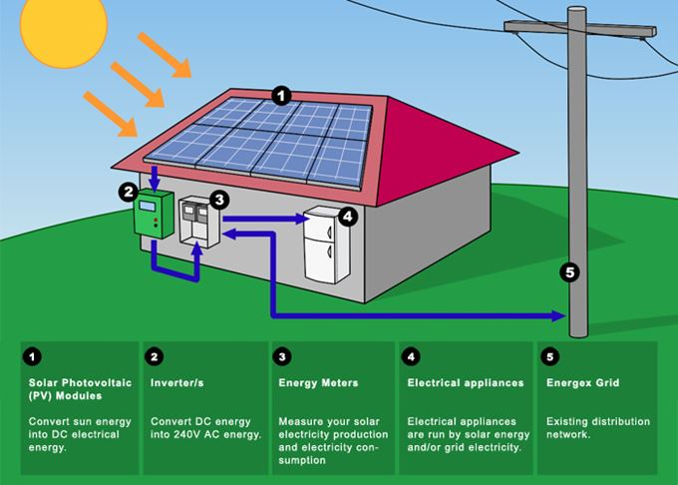
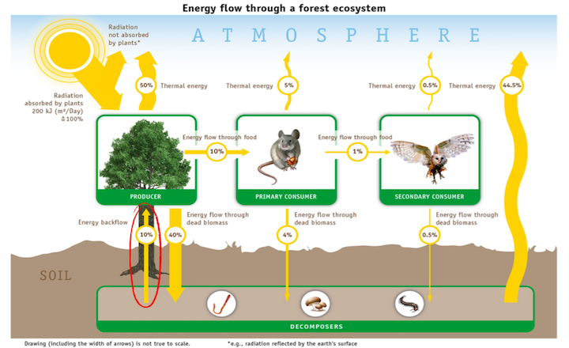
Relevance
How are energy flow diagrams helpful?
Flow diagrams are a simple yet effective way of describing energy transformations.
This way of writing processes is used extensively throughout science (e.g. describing chemical reactions).
Next lesson you will be completing an experiment which will require you to draw flow diagrams.

Slide 15
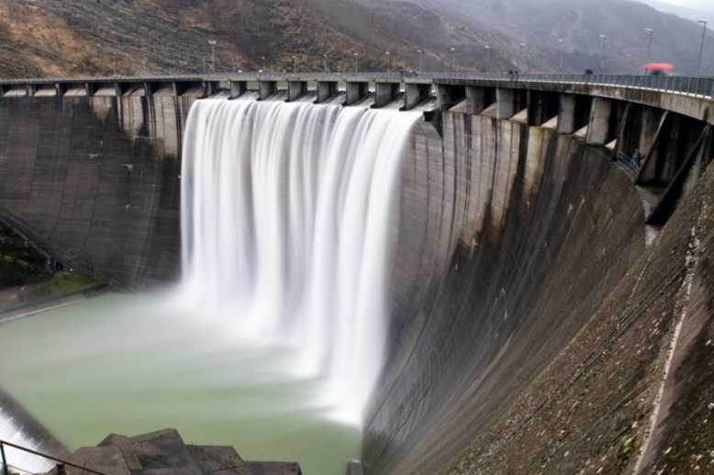
Skill Closure
How do you use an energy flow diagram to show:
Multiple energy transformations?
One form of energy transforming into multiple other forms?
Hydroelectric power plants use the flow of water downstream to turn turbines, which then generate electricity. Represent this process using an energy flow diagram.

Slide 16






Independent Practice
Drawing Energy Flow Diagrams
Identify input (starting) energy form. Identify output (final) energy form/s. Are there any intermediate (in-between) energy forms? Draw a flow diagram: Use arrows to show energy transformation Use + if there are multiple energy forms
Draw an energy flow diagram for the energy transformation(s) in these objects:
2. 2. 3.
4. 5. 6.
Reminder
Kinetic Heat Light Sound Electrical Elastic Gravitational Chemical Nuclear

